Slide 1
76 Point Checklist
Story of How We Applied Techniques from Medicine and Aviation to Migrate MSN to the Cloud

Slide 2
Our Story Starts with a Business that wants to grow and thrive
In 2013 started work on a new vision of the MSN Portal

Slide 3
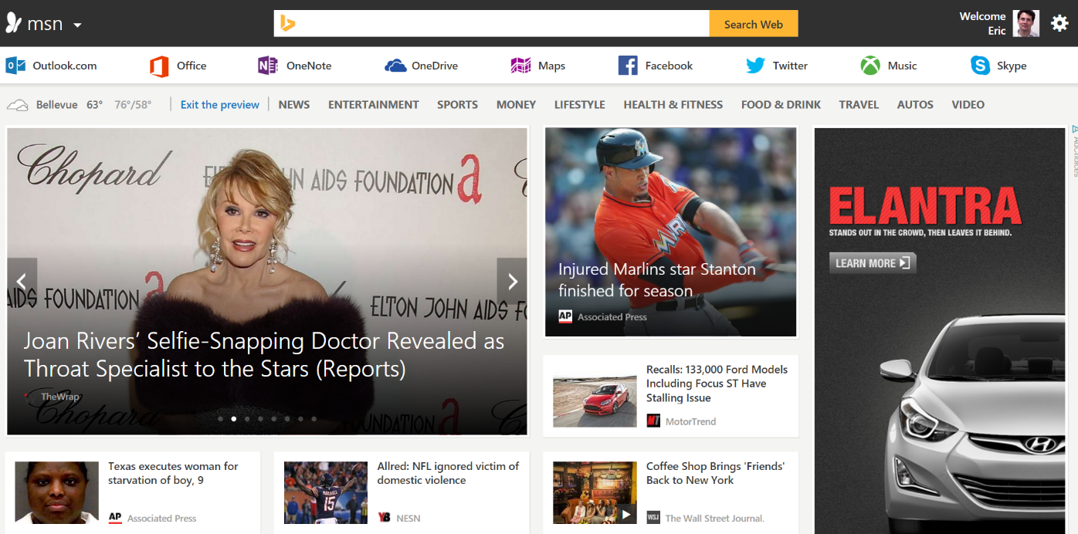
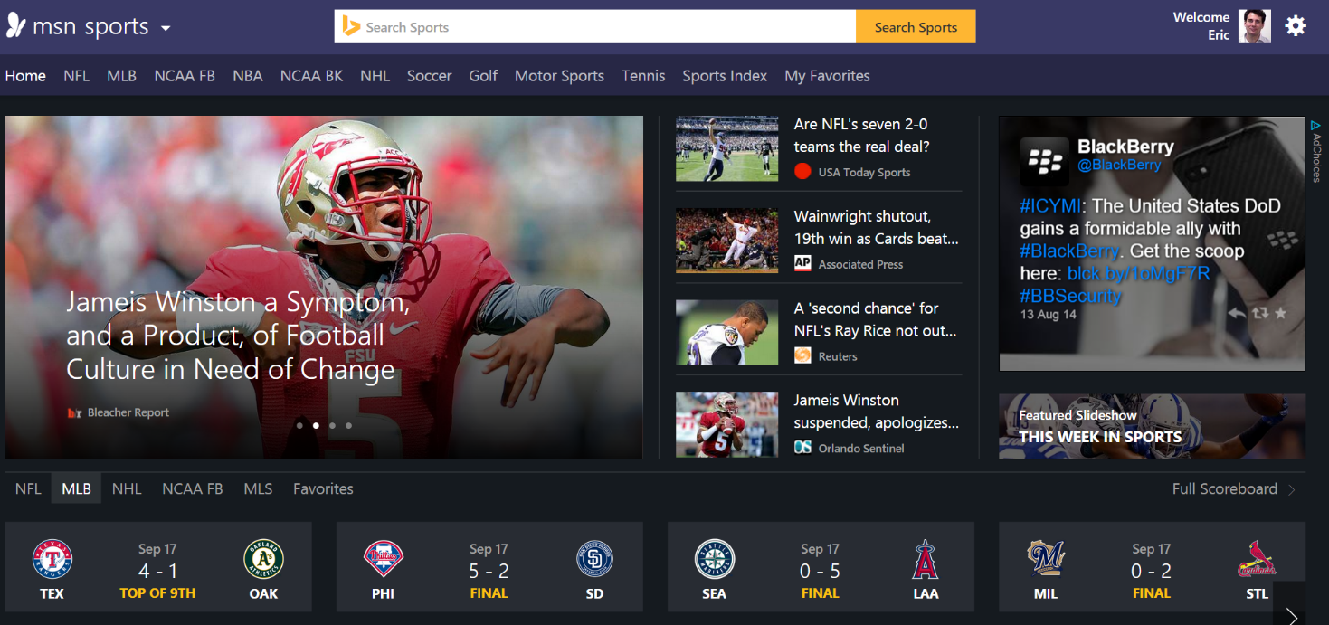
New MSN
Premium Content
New Look
Best Content from Top Publishers
Huge, Diverse Collection of Content
Great Imagery
Stock Quotes
Sports Scores
Weather

Slide 4

MSN is Big
#1 portal
in 26 markets worldwide
Half a billion
monthly users worldwide
18B+
Monthly page views
50
markets
26
languages
$1 Billion a year business
Notes:
We are big, funny story India Team on Size not in our run book (move to later)

Slide 5
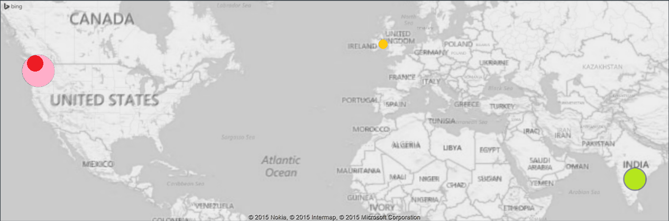
Big Team
475 people in 4 locations Canada, India, Ireland, and United States
Notes:
Communicating Issues, Training and Drilling All get Harder

Slide 6
The Beginning of our Journey
Reaching our goal required a new technology stack

Slide 7

Old Gods - Old Ways Die Hard
Publishing System 10 years old
Nightly reboots
Fear of queue lengths
Many single points of failure
Kitchen Gods by God of Happiness @ Jochi-ji Temple @ Kita-Kamakura by Guilhem Vellut is licensed under a Creative Commons Attribution 4.0 International License.
Notes:
Old System Publishing System was 10 years old, nightly machine reboots, fear of queue lengths , brittle and fragile

Slide 8
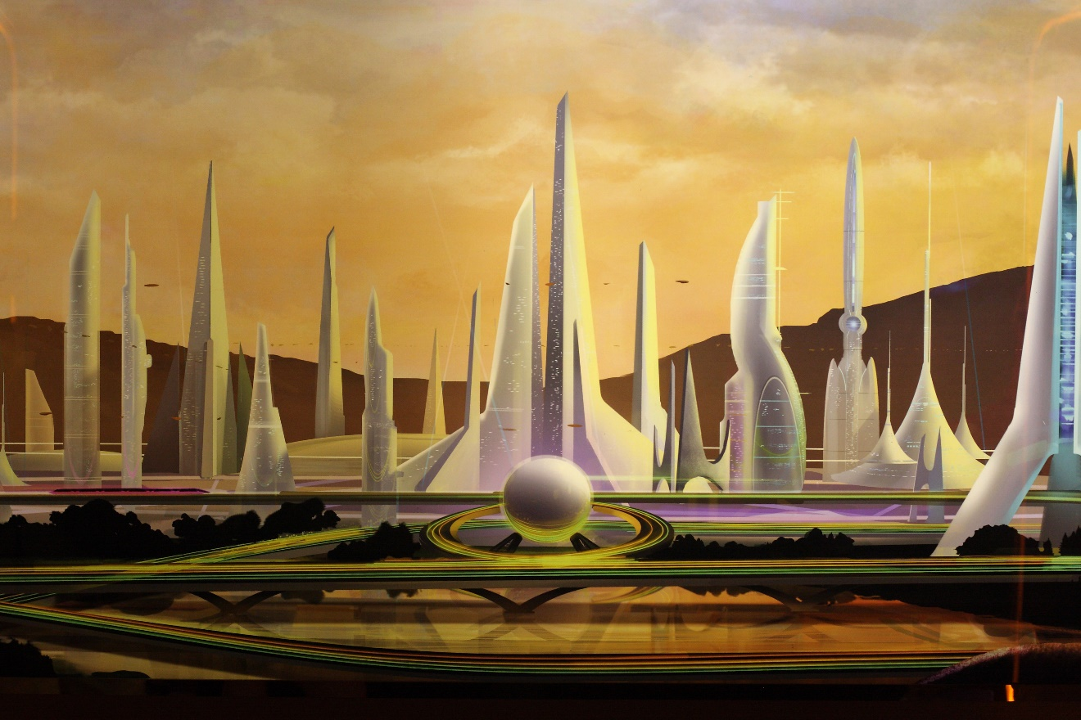
New MSN, New Technology
Our business goals required a new tech stack
Built for the cloud, using the latest technology
Lower cost of ownership
More reliable and scalable
This work Future City by Sam Howzit is licensed under a Creative Commons Attribution 4.0 International License.
Notes:
Chance to fix it all

Slide 9
Now it gets interesting
This is nothing like those other presentations on re-platforming

Slide 10
New Technology Stack
Lots of opportunity
Lots of risk

Slide 11
Lots of Risk
Entirely new “global” cloud with 4 datacenters
New operating procedures for failure and recovery
Notes:
Even more risk

Slide 12
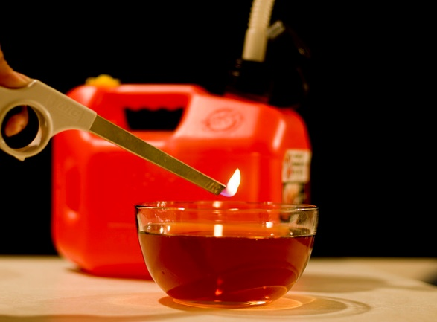
Integration Risk
System visibility required all new services built from the ground up
Co-developed new operational telemetry pipeline
Utilized ElasticSearch and Kibana for diagnostic logs
New dashboards, graphs, monitoring and alerting
This work Risk by Thomas is licensed under a Creative Commons Attribution 4.0 International License.
Notes:
Funny story about deployment scale and support team in India run book

Slide 13
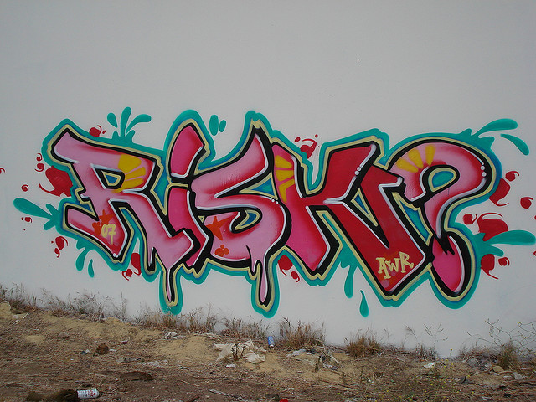
Running At Scale Risks
Scale required new pieces of infrastructure
Storage Service aggregating and sharding across 45 storage accounts
Document cache build from the ground up
New global topology with 4 datacenters and network of edge nodes
This work RISK AWR WC T7L LosAngeles Graffiti Art by A Syn is licensed under a Creative Commons Attribution 4.0 International License.

Slide 14

Risk From New Processes
All new ways of doing things
New deployment processes
Coordination across new teams
Brand new set of tools
This work Creative Teamwork by Creative Sustainability is licensed under a Creative Commons Attribution 4.0 International License.

Slide 15
Then it gets crazier.
You can not make this up if you tried

Slide 16
Launch All At Once
Decision to flip all traffic over on a single day
All regions, all markets, all users
Billions of page views
200 Million users
Notes:
Largest single switchover I have every seen.

Slide 17
Better Plan
Decided to flight 10 percent of traffic for 1 month
Other 90 percent still switched over in one day

Slide 18
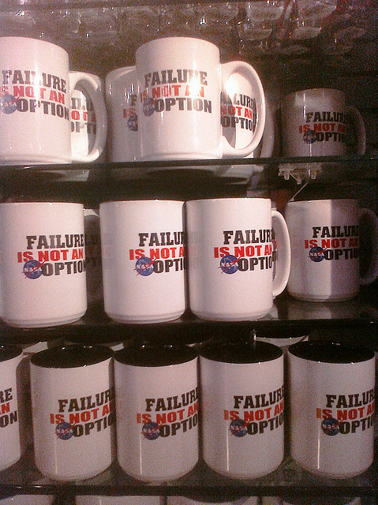
Failure Not An Option
This Failure is not an option Global X by is licensed under a Creative Commons Attribution 4.0 International License.
Notes:
At least he knew

Slide 19
I though I knew what to do.
I was very wrong

Slide 20
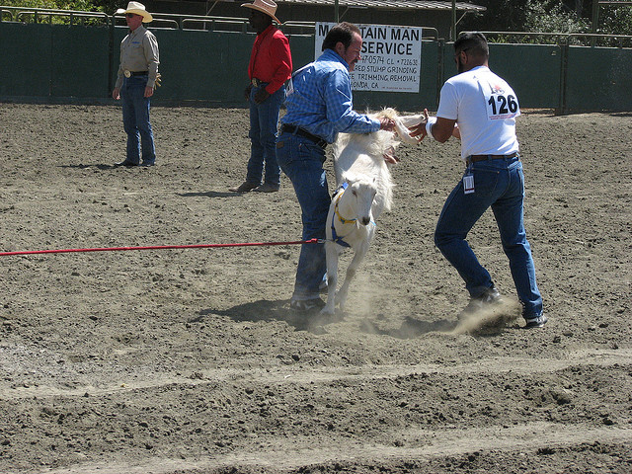
Not My First Goat Rodeo
This work by Andrew Trembley is licensed under a Creative Commons Attribution 4.0 International License
Notes:
I though I knew what do to

Slide 21
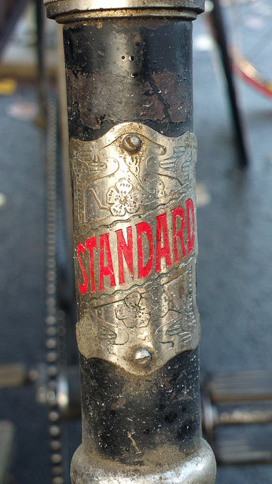
Standard Method
Document First Level Dependencies
Do Failure Mode Analysis
Create a Health Model
This work by Hugovk is licensed under a Creative Commons Attribution 4.0 International License
Notes:
Listen, teach people to fish

Slide 22
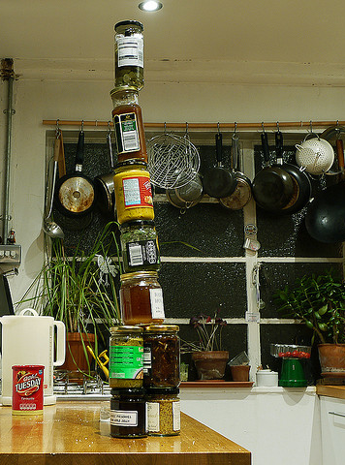
First Level Dependency
The systems you call directly
Often managed by other teams
A clear boundary deserving of tests
Your Application
First Level Dependency
Clearout by Jaypeg is licensed under a Creative Commons Attribution 4.0 International License

Slide 23
Document Dependencies
The Work
Why It Failed
Inventory 1st level downstream services
Ensure services have an SLA
Create high level architecture
Too busy with tight timeline
Seen as extra homework
Teams did not know how the information would be used
Lack of Trust

Slide 24
Failure Mode Analysis
The Work
Why It Failed
Brainstorm failures
Score each failure
Score for impact the bigger the impact the larger the score
Score each failure for frequency the more frequent the larger the score
Multiple impact and frequency
Sort the list of failure by score.
Too tedious, torturous
Tendency to focus on very rare and impactful events
Exhaustive list of data dependent bugs
Only finding the pain not solving the problem
Notes:
– EM Pulse wipes out DC

Slide 25
Health Model
The Work
Why It Failed
Create a set of Mitigations
Associate Mitigation with Failure Modes
Create monitors and alerts to diagnose failure
Automate mitigation as time and knowledge of system allows
Never got past failure modes

Slide 26
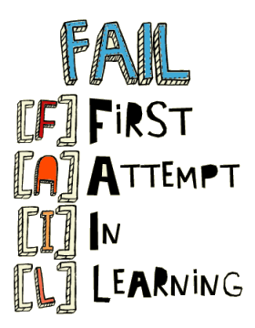
Panic
This work by Jeffery is licensed under a Creative Commons Attribution 4.0 International License
Notes:
Chaos – voice of bane

Slide 27
Birth of the Checklist
The only way out is up

Slide 28
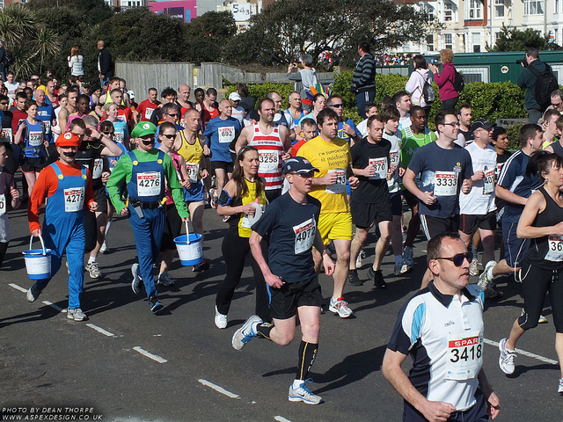
Make DevOps Masters
Needed a new approach
Make DevOps Kung-Fu masters
Practical steps - no more theory
Race teams into shape
2012 Hastings Half Marathon (start) 067 by Dean Thorpe is licensed under a Creative Commons Attribution 4.0 International License

Slide 29

Birth of the Checklist
Be Specific
Four Categories
Twenty two groupings
76 checklist items
Deployment Readiness Exercise checklist by Fort Bragg is licensed under a Creative Commons Attribution 4.0 International License

Slide 30
Four Categories
Pre-Release
13 of 76
Monitoring
29 of 76
Deployment
11 of 76
Mitigation
23 of 76

Slide 31
Pre-Release
Partner
9. Quality gates for partner services and content
Security
10. Prevent URL manipulation
11. Prevent SQL injection
12. Prevent XSS
Automated Process
13. All pre-deployment processes are automated

Slide 32
Monitoring
Logs
48. Code Instrumentation – stack trace for errors
49. Standardize - Logging on inbound and outbound calls including time to receive response, headers sent and received, length of request and response
50. Correlation - Service should maintain and respect activity-id, the context attached to the request
51. Correlation - Service should propagate activity-id, the context to outbound requests
52. Correlation - Service should maintain logging for the duration of the request
53. Log Verbosity – Service should be capable of increasing and/or reducing logging verbosity on per-request basis

Slide 33
Deployment
Rollout
14. Automated Release Process
15. Staged Deployments – deploy a portion of the infrastructure and let it soak.
16. Deployment without service degradation
17. Patching – emergency hotfixes meet TTM goals
Rollback
18. Monitor Deployments and auto-rollback to mitigate
19. Rollback to LKG – rollback take no longer than rollouts
20. Rollback to LKG – data rollouts require rollback

Slide 34
Mitigation
Service Resiliency
69. Auto Retry on 4xx/5xx before aborting
70. Set SLA downstream – mutual agreement with partners and abort long running calls
71. Service Degradation – service degrade gracefully by suppressing specific experiences
72. Configure VIP health – automatically remove VM when service on that node is unhealthy

Slide 35
How We Started: 7 Tasks
Alert using Raw Counters
Alert using Synthetic Probes
Fail your application and validate alerts
Fail central data-services and validate alerts
Ensure errors are in logs
Log requests into central monitoring service
Take basic pager-duty training

Slide 36
How we started: Weekly Process
Assigned 7 tasks to each team
Due Date tied to Public Beta Readiness
Teams reported on status every week

Slide 37

Then We Assigned The Rest
Assigned 69 additional checklist items to teams
Teams picked the ones they wanted to do
Tracked Percentage Complete Across Teams
Organized Knowledge Sharing Sessions to break log jams
How to run an effective meeting checklist by Nguyen Hung Vu is licensed under a Creative Commons Attribution 4.0 International License

Slide 38
Top Five Takeaways
Make a checklist for Failures - Be explicit.
What preventive measures are in place
What are the alerts and who do they go to
What mitigation should be utilized
What are the diagnostics
Introduce Checklist in Waves. Introduce one in each category
Pre-Release and prevention
Monitoring and Alerting
Mitigation of Business Impact
Analyzing and Diagnosing
Do course grain failure tests to validate checklist and learn
Be explicit about how deployments work for code, config, and data
Share Knowledge

Slide 39
Looking For Your Help
Going Big and Broad – 1st Level Dependencies & FMEA
Going Deep and Being Explicit – 100 point checklist
Each method reaches different types of thinkers
How to reach everyone by merging Big-Broad with Deep-Explicit?
Ladder Up - Create a Maturity Model from the Checklist
Prototype –Do one project Big-Broad. Use that experience and move to Deep-Explicit
Games – Teams pick their checklist items and compete to see who does the best in disators

